Slide 1


Fuzzy Energy Systems
18CSC305J Artificial Intellige
18CSC305J Artificial Intelligence – Mini Project
TEAM MEMBERS
RA2111056010012 SURAJ VERMA RA2111056010013 AMAN KASHYAP RA2111056010014 JOES ANTO RA2111056010011 BATHALA SWAMY

Slide 2
ABSTRACT
Problem Statement
Implementing a Fuzzy Logic Controller for Energy-Efficient Building Temperature Regulation.

Slide 3
INTRODUCTION
Sample response of the fuzzy control system for the computation of energy consumption. The resulting fuzzy sets are derived from the highlighted blue and orange surface areas and the bold black line denotes the optimally typical energy consumption value after the defuzzification process.
Minimum energy consumption response values for timesteps. Each timestep is a 10-min interval corresponding to a dataset measurement.

Slide 4
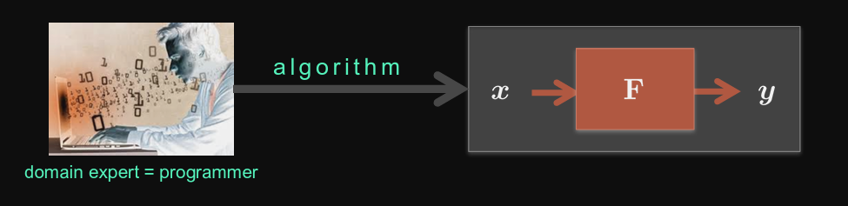
THE ALGORITHMIC APPROACH
ALGORITHM shortest-path(V,T)
Initialize:
W := {v1}
ShortDist[v1] :=0
for each u in V - {v1}:
Shortdist[u] := T[v1,u]
WHILE W != V:
MinDist := INFINITE
For each v in V - W:
If ShortDist[v] < MinDist:
MinDist := ShortDist[v]
w := v
W := W U {w}
For each u in V - W:
ShortDist[u] := Min(ShortDist[u], ShortDist[w] + T[w,u])
Output ShortDist
End Algorithm

Slide 5
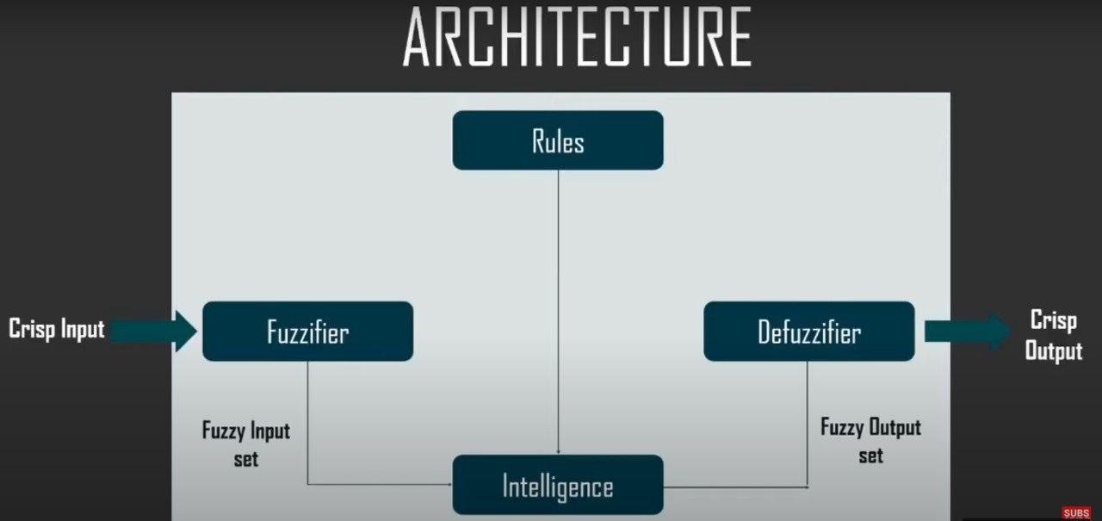
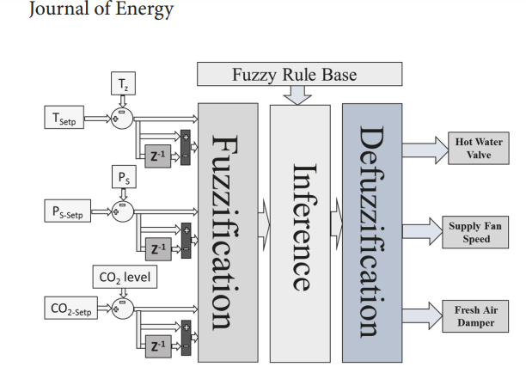
PROPOSED WORK

Slide 6
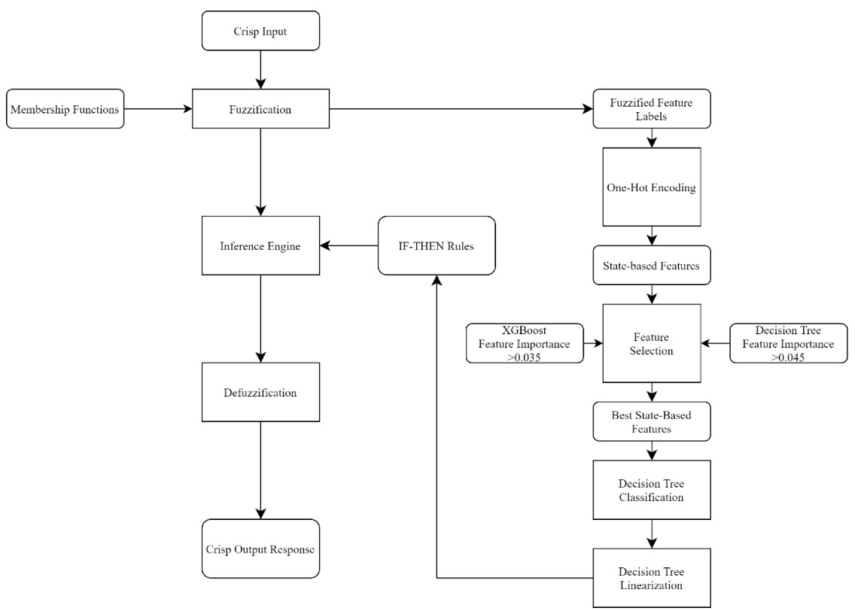
PROTOTYPE

Slide 7
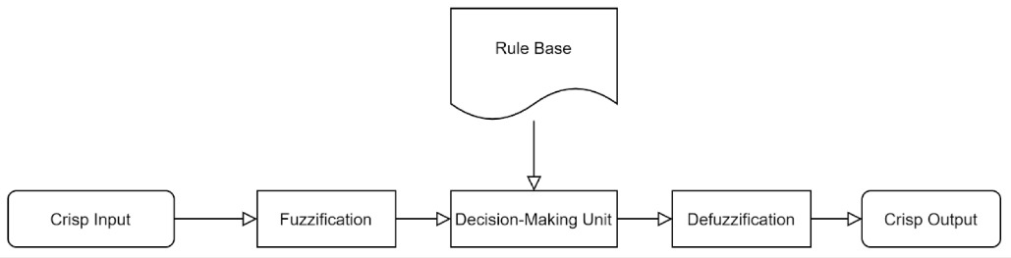
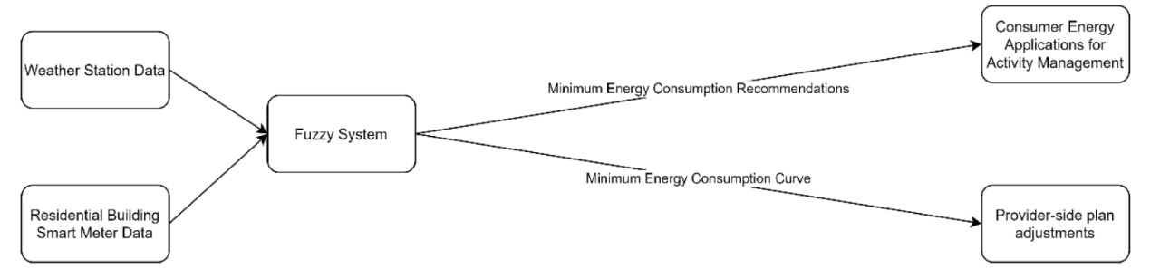
Fuzzy Logic Energy System

Slide 8
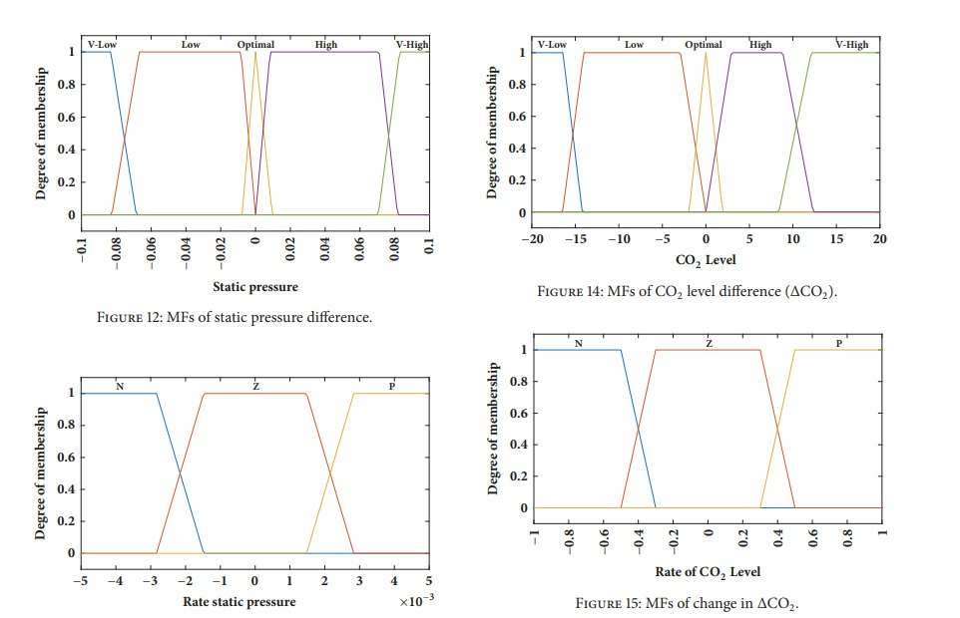

Slide 9
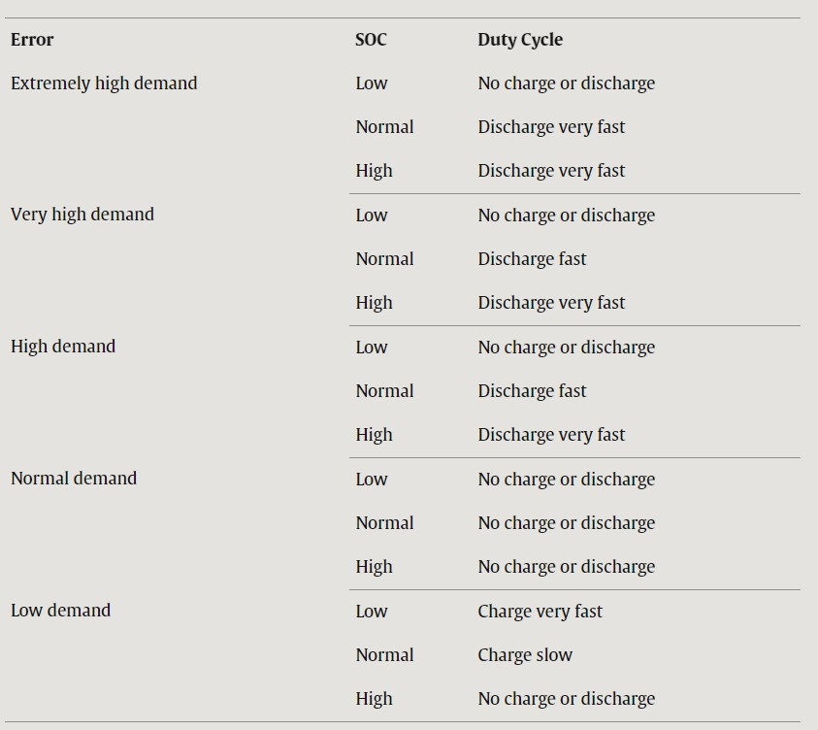
Fuzzy Control System for Smart Energy Management in Residential Buildings Based on Environmental Data

Slide 10
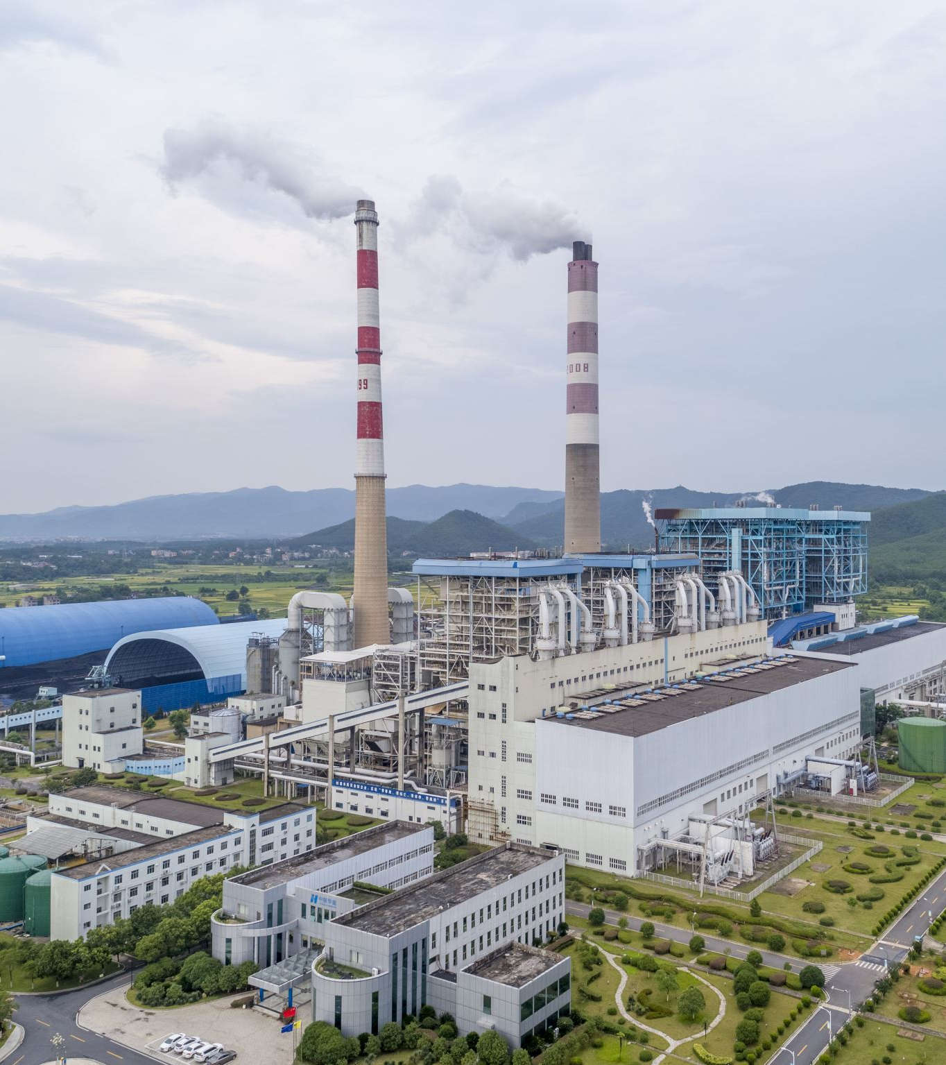
Fuzzy Control Systems
Exploring the role of fuzzy control systems in optimizing energy processes, such as power generation, renewable energy integration, and smart grid operation. Highlighting the advantages of using fuzzy logic for adaptive and robust control.

Slide 11


Slide 12
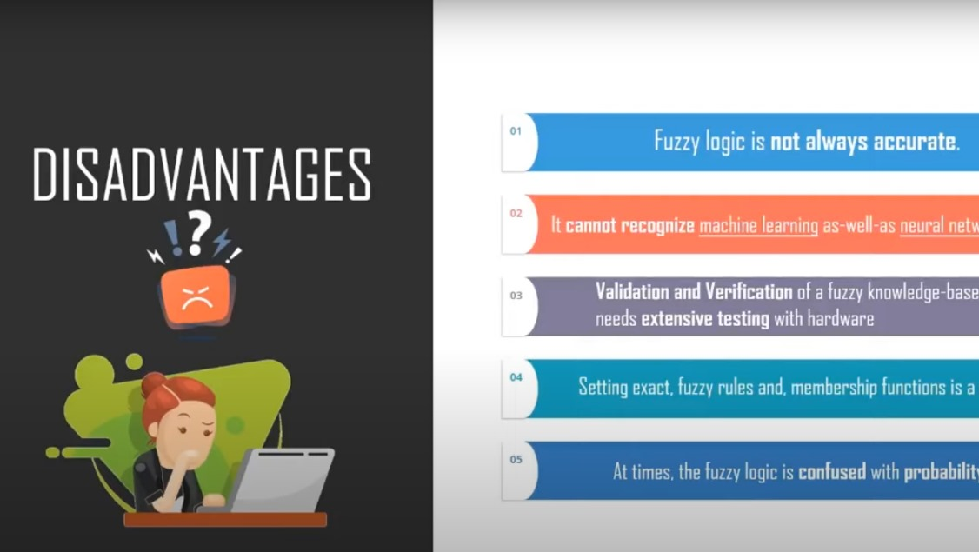

Slide 13
REFERENCES
Energies | Free Full-Text | Fuzzy Control System for Smart Energy Management in Residential Buildings Based on Environmental Data (mdpi.com)
https://doi.org/10.1016/j.enbuild.2017.01.083
EVIA2017 - Wednesday - 03 - Eyke Hullermeier - Fuzzy Logic in Machine Learning.pdf (usc.es)

Slide 14



